Slide 1
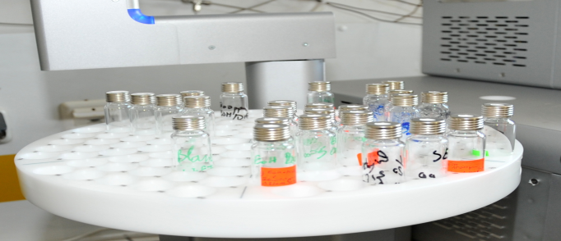
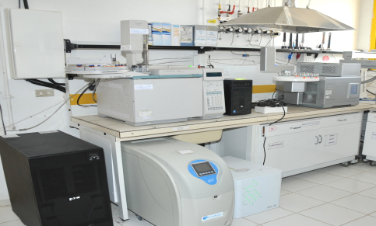
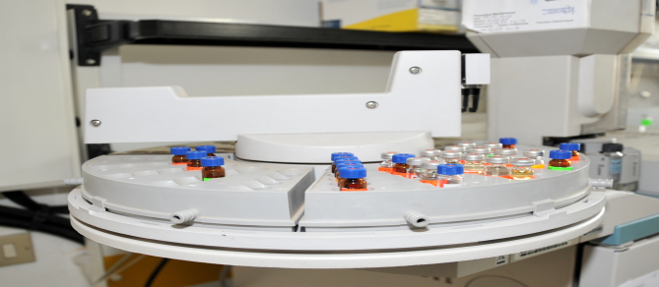
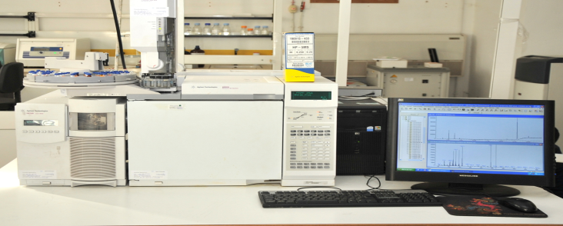





Nanoparticules: Analytical strategies and Applications
WorkShop on Nanoparticules from 21 to 25 th March 2022
Pau (France)
Organised by:
Fabienne Séby & Mathieu Menta
UT2A, Hélioparc, France
Funded by the Horizon 2020 Framework Programme of the European Union
under the grant N° 952306

Slide 2
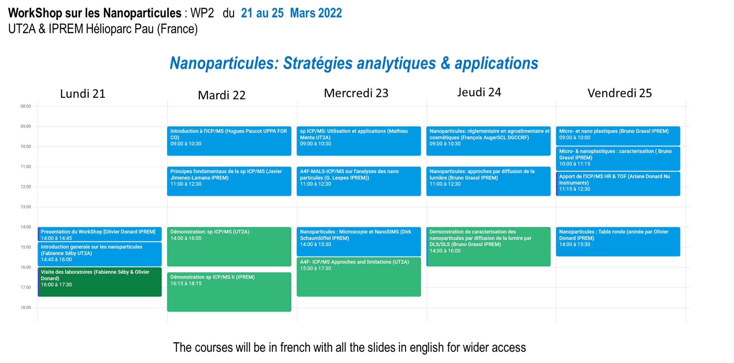
Nanoparticules: Analytical strategies and Applications

Slide 3
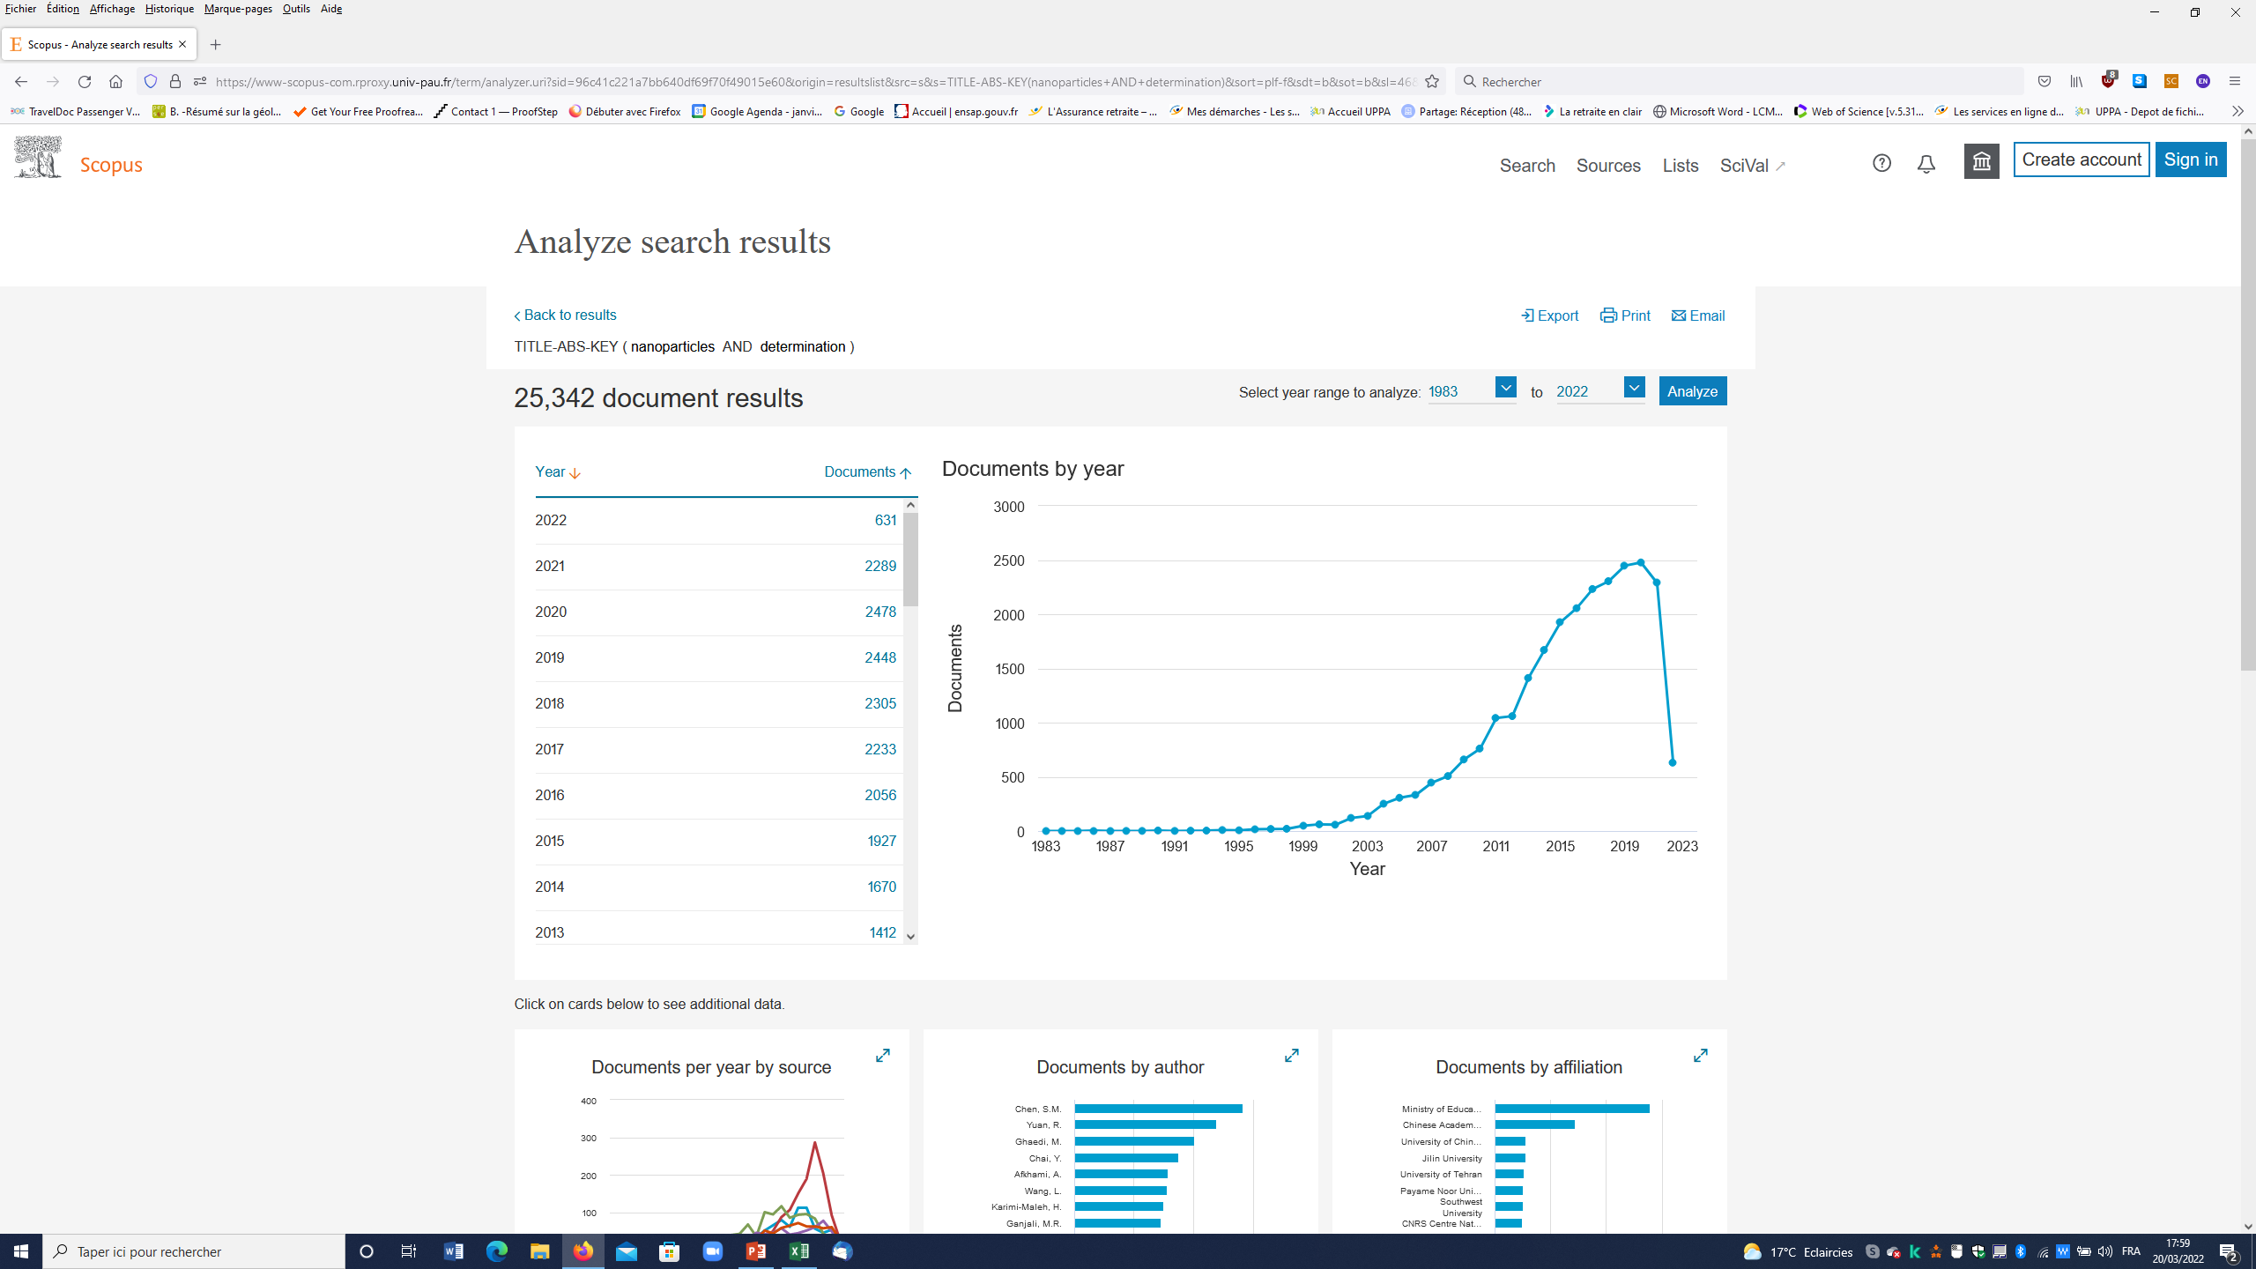

Scopus: Nanoparticles AND determination
Funded by the Horizon 2020 Framework Programme of the European Union
under the grant N° 952306

Slide 4
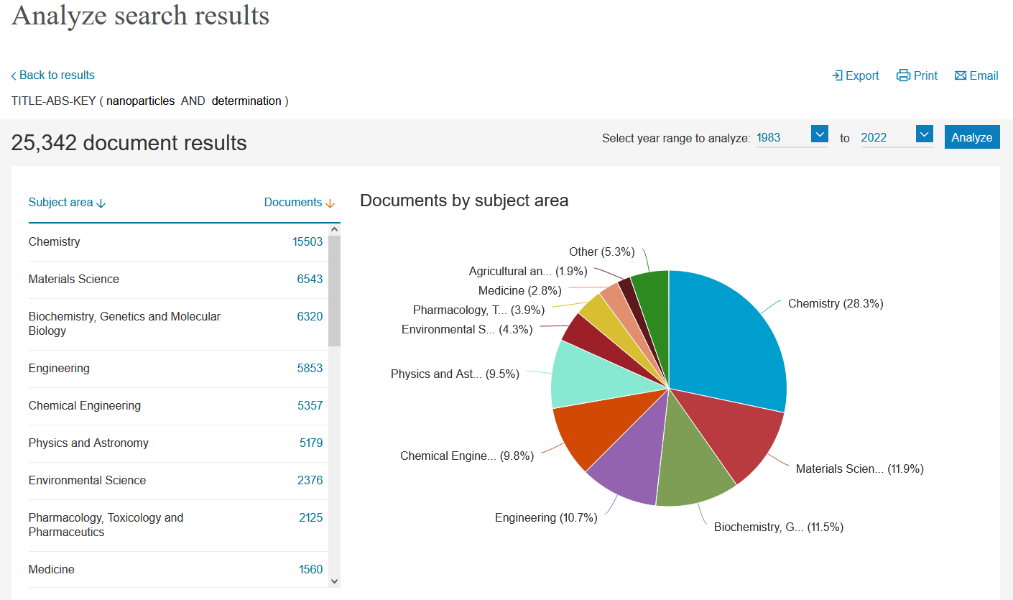
Scopus: Nanoparticles AND determination
Funded by the Horizon 2020 Framework Programme of the European Union
under the grant N° 952306

Slide 5
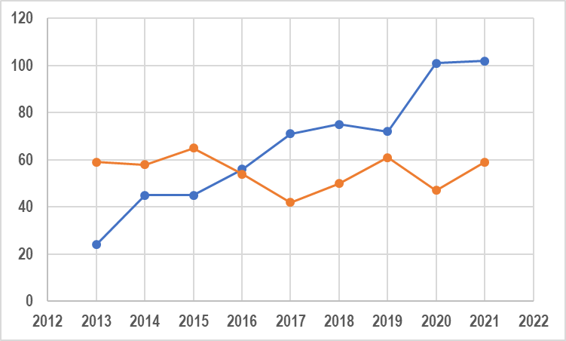
Evolution of the methods for characterization of NanoParticles : sp ICP/MS & A4F
sp ICP/MS
Field Flow Fractionation
Nb. of Articles
Year
Funded by the Horizon 2020 Framework Programme of the European Union
under the grant N° 952306

Slide 6
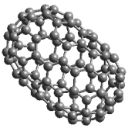
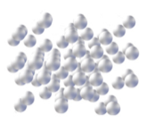
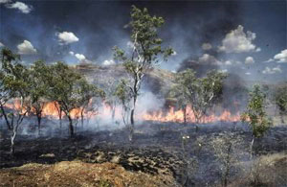
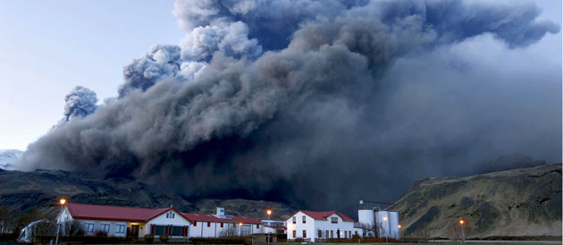
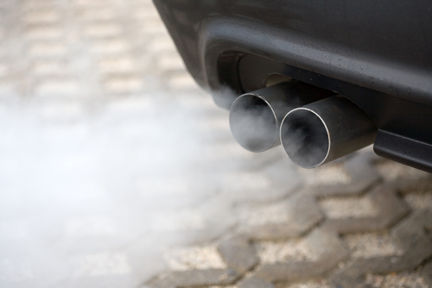
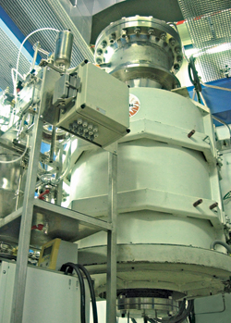

Controlled or not controlled
Production of nanoparticles
Les enjeux environnementaux :
Caractérisation des nano-structures
Olivier F.X. Donard
LCABIE/IPREM
UMR CNRS 5254
Pau (France)
Non controlled
Controlled
Premières rencontres Chemstart’up:
Enjeux et Compétivité des Nanomatériaux
18 & 19 Mai 2010 Pau (France)
Funded by the Horizon 2020 Framework Programme of the European Union
under the grant N° 952306

Slide 7

Analytical strategies for nanoparticules caracterisation

Slide 8
Caracterisation in solid phase
Caractérisation en phase solide
C. Derail, L. Billon EPCP/IPREM
TEM images of raw ZnO nanorods (left) and core@shell of ZnO@polymer hybrids (right)
Funded by the Horizon 2020 Framework Programme of the European Union
under the grant N° 952306

Slide 9
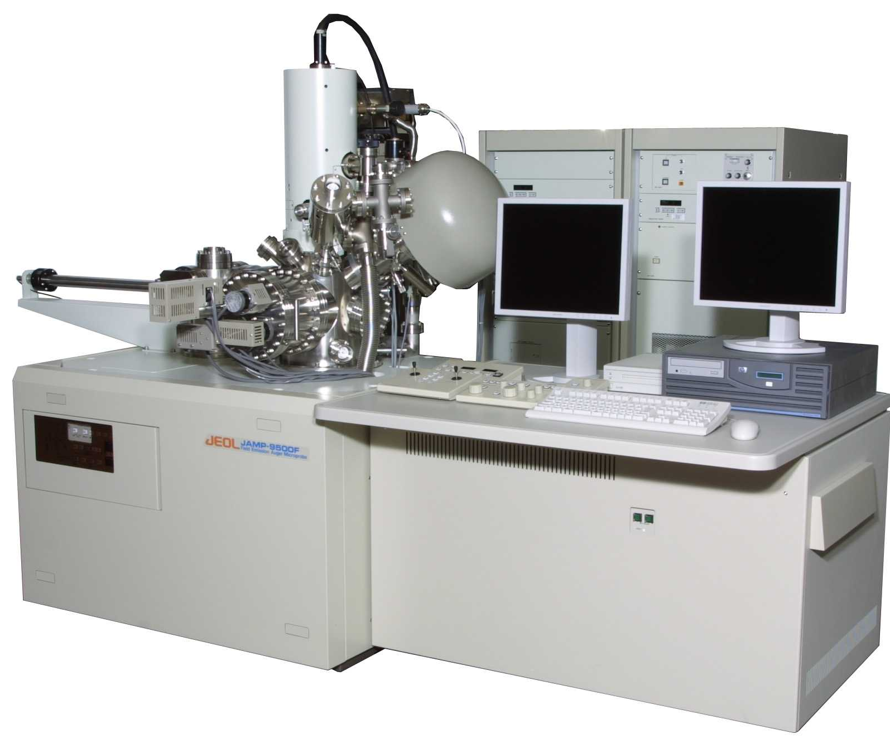
Caracterisation in solid phase / surfaces
Nanosonde AUGER - Probes
JEOL : JAMP-9500F
SEM Imaging
Auger Spectra
Cartography SAM
- Nanometer scale 3nm (SEM) et 8nm (SAM)
Funded by the Horizon 2020 Framework Programme of the European Union
under the grant N° 952306

Slide 10
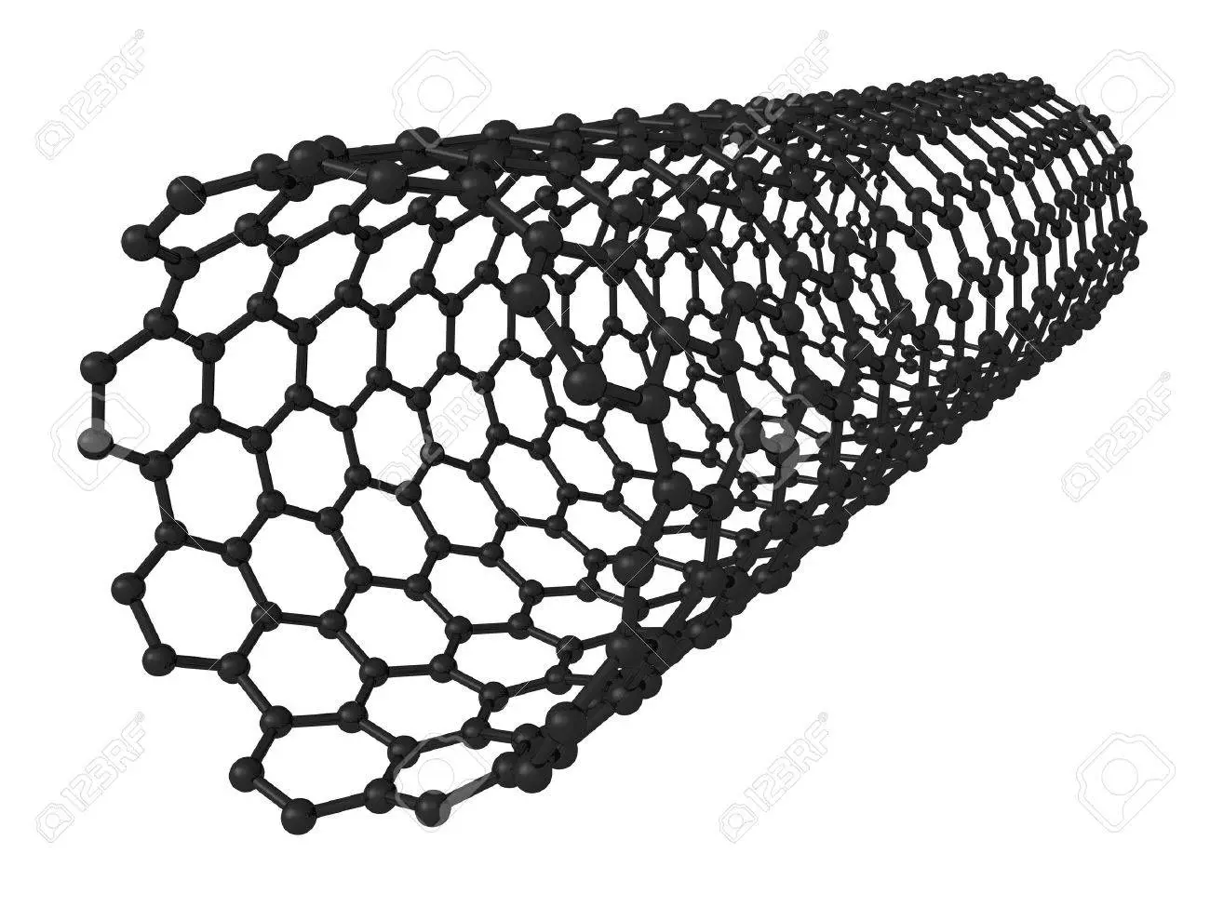
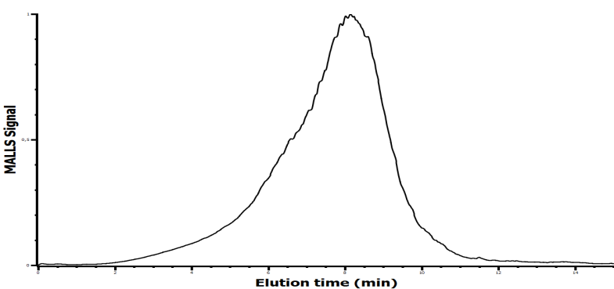
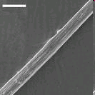
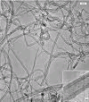

Caracterisation in liquid phase
Ex : Caracterisation of Carbon Nano Tubes (SWCNT et MWCNT)
INFO OBTAINED :
Size distrubution
Gamme de longueur :
L_{min} = (150 ± 5) nm
L_{max} = (2500 ± 100) nm)
Diamètre :
Ø = (1,2 ± 0,2) nm
Funded by the Horizon 2020 Framework Programme of the European Union
under the grant N° 952306

Slide 11
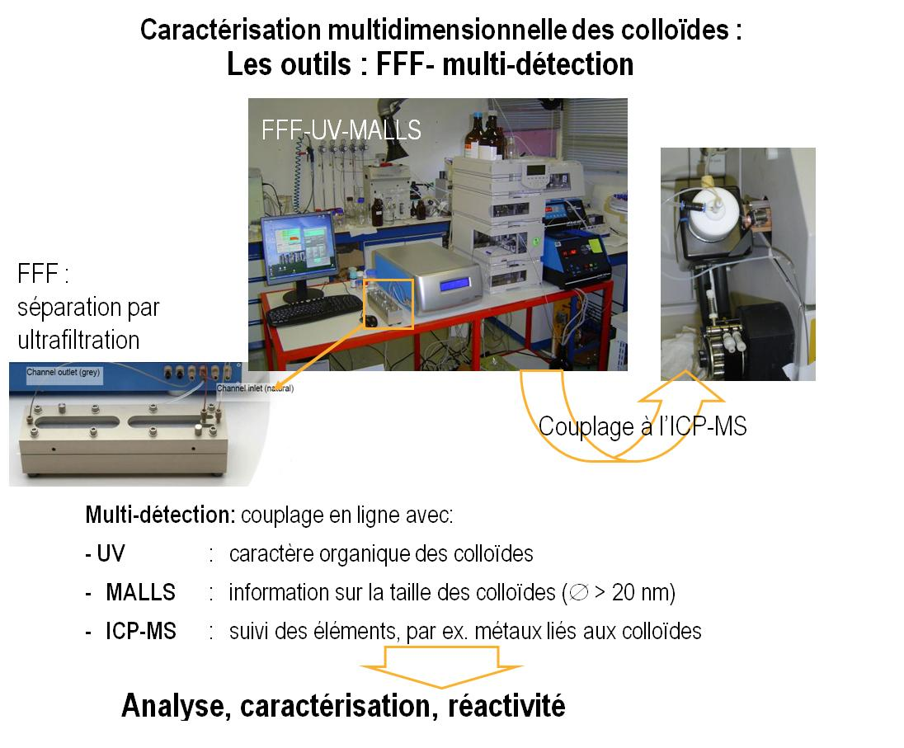
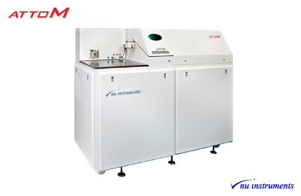
Caracterisation in liquid phase

Slide 12
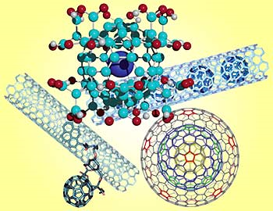
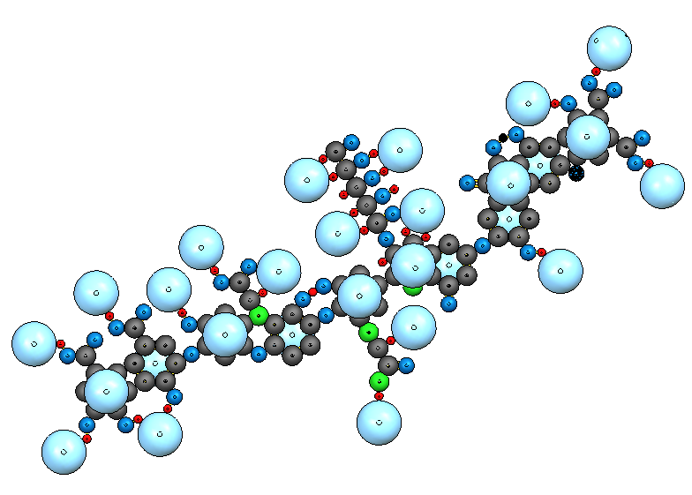
Organic world
Organic world
Carbon nanoparticules
Funded by the Horizon 2020 Framework Programme of the European Union
under the grant N° 952306

Slide 13
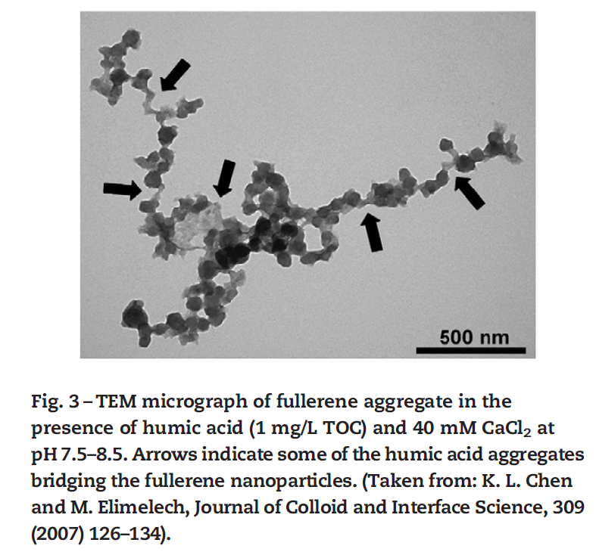
Real life!

Slide 14
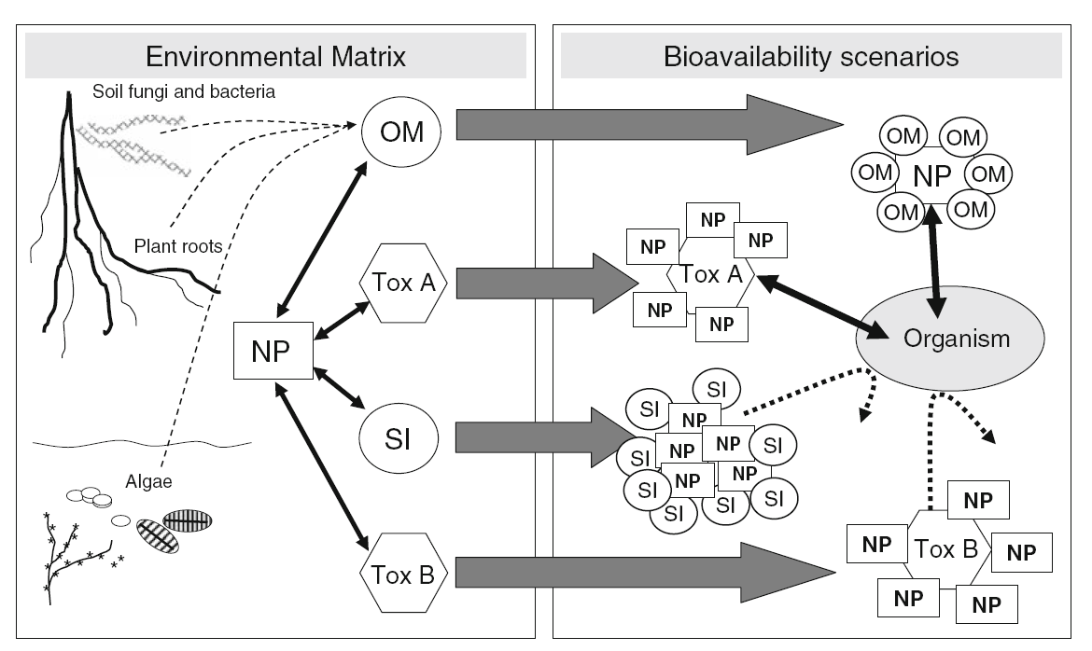
Evolution of Nanoparticules in the Environment
Environmental behavior and ecotoxicity of engineered nanoparticles to algae, plants, and fungi
E. Navarro et al.
Ecotoxicology (2008) 17: 372
Funded by the Horizon 2020 Framework Programme of the European Union
under the grant N° 952306

Slide 15

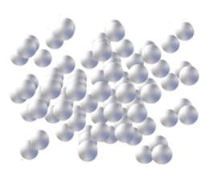
Analytical Strategies for NanoParticles caracterisation in the Environment
Preconcentration
Dissociation
Purification
Phase transfer
Detection/Identification/Quantification
ICP/MS HR
ICP/MS MC
Femt.LA-ICP/MS HR/MC
SM
MALDI TOF
FTICR MS
Caracterisation
Shape
AFM
SEM
TEM
Surface
XPS
Nano Sonde Auger
TOF SIMS
Nano SIMS
Separation
Chromatographies
SEC
FFF
2D
n
Funded by the Horizon 2020 Framework Programme of the European Union
under the grant N° 952306

Slide 16
Nanoparticules: Analytical strategies and Applications

